Slide 1



Financial Data Analysis
View in Power BI
Last data refresh:
26/04/2025 16:15:48 UTC
Downloaded at:
26/04/2025 16:16:34 UTC

Slide 2
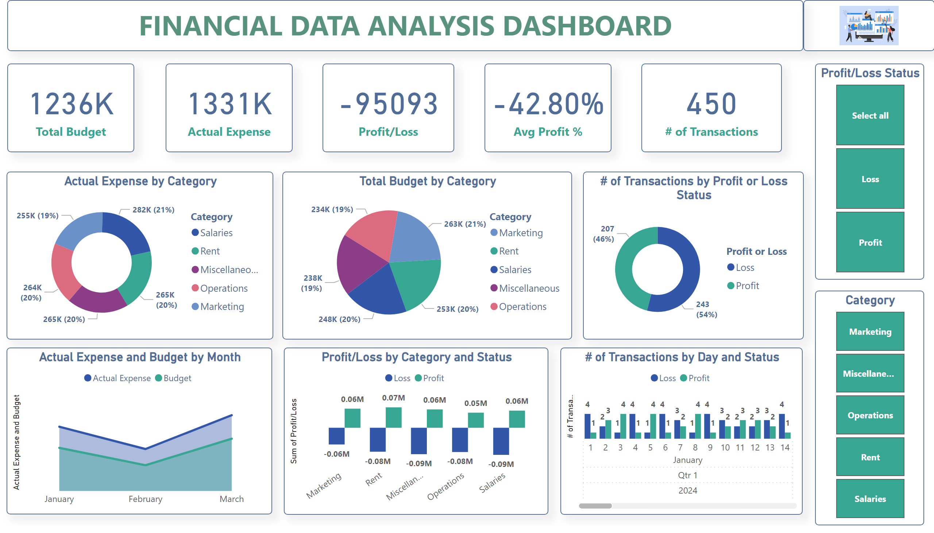
Page 1
Notes:
textbox
No alt text provided
image
No alt text provided
card
No alt text provided
card
No alt text provided
card
No alt text provided
card
No alt text provided
Profit/Loss Status
No alt text provided
card
No alt text provided
Category
No alt text provided
Actual Expense by Category
No alt text provided
Total Budget by Category
No alt text provided
# of Transactions by Profit or Loss Status
No alt text provided
areaChart
No alt text provided
Profit/Loss by Category and Status
No alt text provided
# of Transactions by Day and Status
No alt text provided

